Slide 1
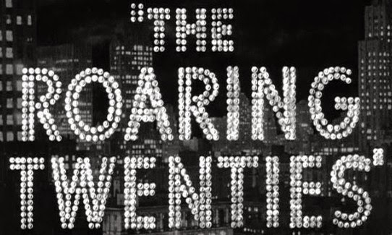

Slide 2
The story far…
1865-1900
1900-1919
1919-1921
Notes:
1865-1900 (Post-Civil War era, Second Industrial Revolution, Gilded Age)
1900-1919 (T. Roosevelt, W. Taft, W. Wilson, Henry Ford and assembly line, WW1)
1919-1921 (W. Wilson and 14 points, Red Summer, Red Scare, 19th Amendment, Harding ‘return to normalcy’)

Slide 3

The Roaring 20's: Crash Course US History #32
https://www.youtube.com/watch?v=VfOR1XCMf7A

Slide 4
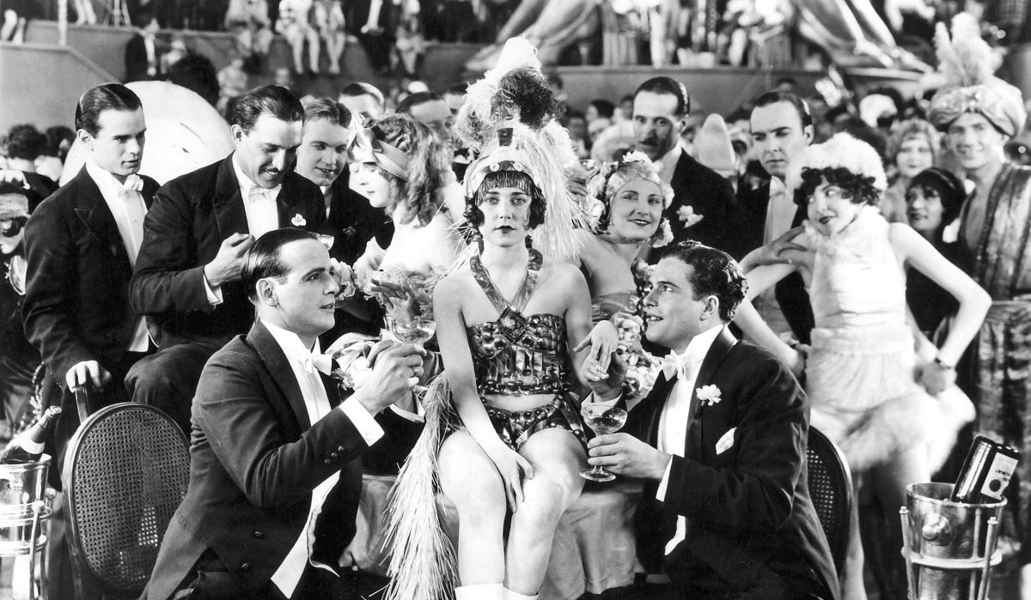
Other names given to the Roaring Twenties
The Golden Twenties
The Decade of Prosperity
The Republican Decade
The Jazz Age
The Period of Plenty

Slide 5
Reasons for economic prosperity
Increased efficiency of US industry
Improved transportation
Better marketing and sales strategies
Catchy slogans
Advertising through radio, newspaper, magazines
Invention and development of new goods and the variety of choices
New consumer items – cigarette lighters, radios
The ease of obtaining finance
Loans grew from $32b in 1919 to $60b in 1929
The growth of large (super) corporations
The policies of the Republican Government
Laissez-Faire
High tariffs on foreign goods

Slide 6
Industries of the 1920s
Sales of motor vehicles | 1919 | 1929
Passenger cars | 1.6 million | 4.5 million
Trucks and busses | 0.9 million | 3.5 million
tractors | 0.25 million | 0.5 million
The motor vehicle industry was the most important of the period, contributing 13% of manufacturing production and 4 million jobs.
Other industries that experienced rapid expansion in the period were:
Electricity
Banking and finance
Advertising, newspapers, magazines, radio and film

Slide 7
Groups ‘excluded’ from the prosperity of the 1920s
Farmers (mid-west and south)
‘Staple’ industry workers (textiles, coal-mining and railways formerly USA’s staple)
Blacks, Asians, Hispanics and American Indians
Unemployed people suffered because of lack of welfare services
Catholics and Jewish people
Immigrants from all nations and ethnic groups

Slide 8
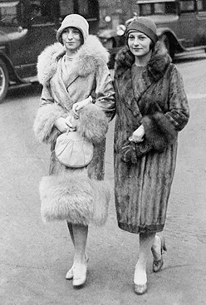
Women
19th Amendment (1919) gave women the right to vote.
The Great War emancipated women in many ways:
Women found work in newly emerging areas of the economy
Women ‘played’ the stock exchange
The more emancipated women became known as ‘flappers’.
Drinking and smoking in public
Dance styles
Driving cars and riding on motorbikes
Using makeup
Bobbing of hair
Whilst women enjoyed a greater degree of freedom during the 1920s, they did not enjoy economic or social equality with males.

Slide 9
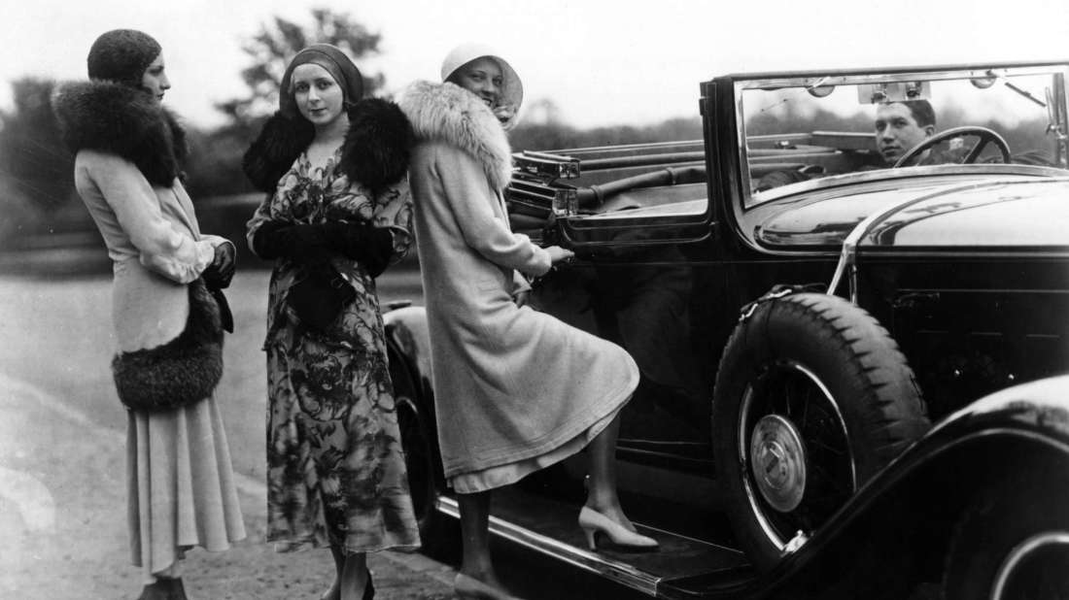
Popular activities during the 1920s
Increased wealth and leisure time by the majority of people led to the search for entertainment and diversion.
Popular people
Babe Ruth
Charlie Chaplin
Popular activities included:
Films
Music-jazz
Radio
Sport
Popular pursuits
Pole sitting
Sunday drives
Parties
Gambling

Slide 10
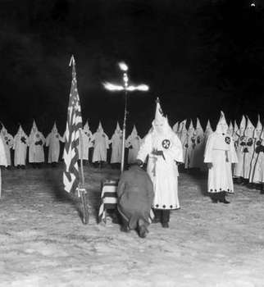
Violence and intolerance during the 1920s
Racial/ethnic
Ku Klux Klan
Immigration Restriction Acts
Political
Red Scare 1919-1920
Social
Volstead Act/18th Amendment 1920 – abolition of intoxicating liquor (drinks containing 0.5% of alcohol or more)
Sacco and Vanzetti immigrant anarchists

Slide 11
Prohibition – ‘The Noble Experiment’
January 29, 1919 - 18th Amendment (came into effect a year later)
October 1919, Congress passed National Prohibition Act/Volstead Act
Women played a strong role in the temperance movement, as alcohol was seen as a destructive force in families and marriages.
Anti-Saloon League
Ultimately, Prohibition failed.
Created gangster ideals (Al Capone)
Bootlegging, moonshine
Speakeasies
Rise of criminal activity
“A great social and economic experiment, noble in motive and far reaching in purpose.” –Herbert Hoover

Slide 12
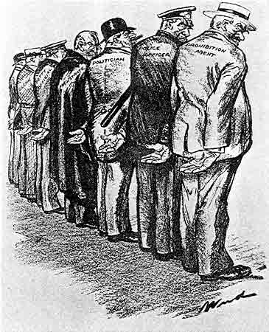
Message 1926 cartoon by Clive Weed in the satirical weekly Judge about Prohibition.

Slide 13
Author’s perspective
“…every criminal, every gambler, every thug, every libertine, every girl-ruiner, every home-wrecker, every wife-beater, every dope-peddler, every moonshiner, every crooked politician, every pagan papist priest…every Roman controlled newspaper, every hyphenated American, every lawless alien…”
In 1926, in a Kansas newspaper, the Klan described who they were fighting against.

Slide 14
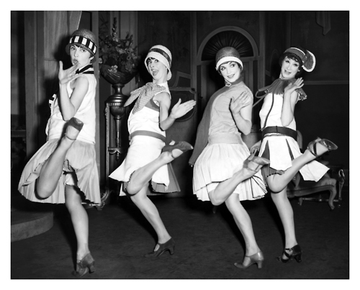
To what extent is source 3 useful in explaining the changes in society in the United States in the 1920s?
Flappers, circa 1920s
Notes:
Does it teach us anything? It teaches us about women’s behaviour and fashion, but does not teach us about other women in society who opposed these changes.

Slide 15
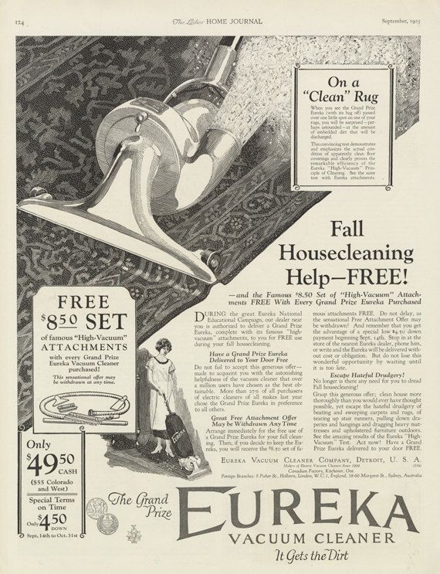
Historical context (what, when, cause, effect)
1925 Eureka Vacuum Cleaner Advertisement

Slide 16
Evaluate the extent to which the sources give an accurate insight into the time period.

